Slide 1
TECH CONNECT IT x CONNECTWISE
Give Your Techs Their Time Back.
How AI agentic AI helps Tech Connect IT save time, save money, and scale without adding headcount
Presented to Tec Connect IT | April 2026

Slide 2
Agenda
1
What We Heard
2
Why ConnectWise
3
How We Help
4
What Success Looks Like
5
Customer Story
6
Next Steps & Partnership
Tech Connect IT | ConnectWise Partnership
2

Slide 3
What We Heard
Based on our conversations with the Tech Connect IT team
What's Not Working Today
What Tech Connect IT Wants to Achieve
Technicians buried in Tier 1 tickets: password resets, triage, routing, hours lost to repetitive work every day
Manual ticket triage slows response times and creates inconsistent customer experience
Growth is capped by headcount, scaling support means hiring, not working smarter
Techs want to do meaningful, higher-value work but can't get out of the queue
Free up technician hours for proactive, revenue-generating, customer-facing work
Speed up response and resolution times without adding to the roster
Scale the service desk to support growth — not headcount
Build a more predictable, consistent service experience for clients
Tech Connect IT | ConnectWise Partnership
3

Slide 4
Why ConnectWise
We're not here to sell a product. We're here to help MSPs make money and save money.
Already in Your Stack
40+ Years Backing MSPs
A True Platform, Not a Point Tool
ConnectWise PSA and RMM already run day-to-day service delivery, AI builds directly on data you already have
Purpose-built for the MSP model, not a generic add-on, the entire platform is designed around how you operate
PSA, RMM, cybersecurity, data protection, and now agentic AI, one ecosystem instead of stitched-together tools
Tech Connect IT | ConnectWise Partnership
4

Slide 5
How We Help
Agentic AI, native to the ConnectWise platform
Auto-Triage & Routing
Agents classify, prioritize, and route tickets the moment they land — no manual sorting required
Executes, Doesn't Just Suggest
Unlike a chatbot or copilot, zofiQ takes action inside the workflow — closed-loop from intake through resolution
Built-In Oversight
An Oversight Agent monitors every ticket and SLA, flagging risk and keeping quality and compliance in check
Up and Running Fast
Learns from the PSA, RMM, and knowledge base data you already have — live in under 30 minutes, no complex workflow-building
Tech Connect IT | ConnectWise Partnership
5

Slide 6
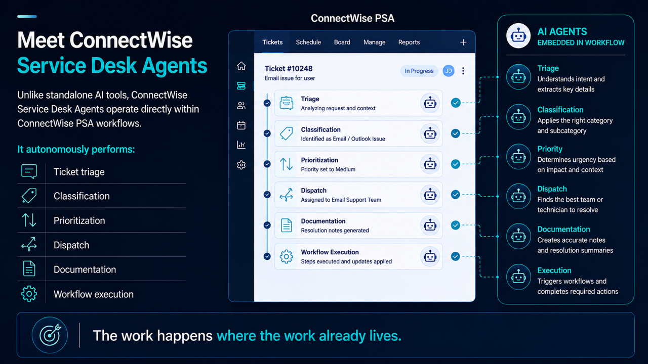
Notes:
Service Desk Agents in Action
Up to this point, we've talked about the challenge and the operating model.
Now let's look at how ConnectWise Service Desk Agents bring that model to life.
The Work Happens Inside PSA
One of the biggest limitations of many AI solutions is that they sit outside the systems where work actually happens.
They provide recommendations.
They generate summaries.
They offer guidance.
But someone still has to take that information and perform the work.
ConnectWise Service Desk Agents take a different approach.
They operate directly inside ConnectWise PSA.
The work happens where the work already lives.
What Service Desk Agents Do
As tickets enter PSA, Service Desk Agents can:
Triage requests.
Classify tickets.
Set priorities.
Assign work.
Generate documentation.
Execute workflow actions.
Instead of acting as a separate tool, the agents become part of the operational workflow.
From Recommendations to Action
This is an important distinction.
A copilot might create a great summary.
But someone still needs to review it, route the ticket, update fields, and move the work forward.
Service Desk Agents go beyond recommendations.
They help move the ticket through the workflow automatically.
Less manual handling.
Less waiting.
Less administrative work.
Why It Matters
Value isn't created when AI generates an answer.
Value is created when work gets completed accurately, consistently, and at scale.
That's why Service Desk Agents focus on workflow outcomes.
Fewer manual touches.
Fewer reassignments.
Faster time to resolution.
More consistency across the Service Desk.
The Business Impact
This isn't about replacing technicians.
It's about removing the repetitive work that slows them down.
AI handles the preparation.
Technicians focus on resolution.
The result is a Service Desk that operates faster, more consistently, and with greater capacity than traditional human-only models.
Reflect
When L1 routes a ticket today, the path is manual end to end. Copy-paste, KB lookup, documentation slow under pressure, and up to 25% of tickets reassigned or escalated.
You want agents native in PSA to triage, classify, and assign. That is the fix you described.

Slide 7
What Your Success Looks Like
Service Desk Profile
Time Spent Per Ticket
Metric | Value
Total tickets per month | 5,000
PSA users (technicians, dispatchers & related) | 49
Avg. fully loaded technician cost / hour | $33.45
Total tickets per year | 60,000
Task | What's Included
Triage / Intake | Review, categorize, understand, initial response
Dispatch / Routing | Manual assignment, routing, prioritization
Documentation / Admin | Notes, summary, time entry, updates
Total minutes per ticket | 9 minutes
Tech Connect IT | ConnectWise Partnership
7

Slide 8
Operational Assumptions
Assumption | Value | What It Means
AI efficiency capture rate | 35.0% | Portion of time reclaimed once AI is fully adopted
AI resolution accuracy | 90.0% | Based on early partner outcomes
Escalation rate today | 10.0% | Share of tickets escalated without AI
Escalation reduction with AI | 50.0% | Reduction in escalated ticket volume
Avg. tickets per technician / day | 7 | Used for capacity modeling
Tech Connect IT | ConnectWise Partnership
8

Slide 9
Estimated Annual Value
A$181,058
Net Annual Value
364%
Estimated ROI
3.30 months
Payback Period
1.75
FTE Gained
Operational Capacity Gains
Minutes reclaimed per ticket | 3.15
Minutes reclaimed per month | 15,750
Hours reclaimed per month | 262.50
Hours reclaimed per year | 3,150
Additional tickets handled / month | 245.0
Additional tickets handled / year | 2,940
Increase in service capacity | 4.9%
Annual productivity value | A$105,368
Tech Connect IT | ConnectWise Partnership
9

Slide 10
Pre-Session
Up and Running
Fast
<30
Learns from the PSA, RMM, and knowledge base data you already have — live in under 30 minutes, no complex workflow-building.
minutes
live & operational
No migration, no heavy configuration — zofiQ reads your existing data and is ready to act.
Reads existing PSA & RMM data
Step 1 — Setup
Create PSA API member
No migration required
Complete data migration
Zero complex configuration
Wait ~7 days for AI to learn from data
Tech Connect IT | ConnectWise Partnership
01

Slide 11
Enablement
Auto-Triage, Routing & Execution
From the moment a ticket lands, zofiQ classifies, routes, and resolves — end to end, no human sorting required.
Step 2 — Session I
Onboarding Checklist
Auto-Triage & Routing
Executes, Doesn't Just Suggest
Add zofiQ pod into PSA
Agents classify, prioritize, and route tickets the moment they land — no manual sorting required. Every ticket reaches the right queue instantly, without a technician touching the inbox.
Unlike a chatbot or copilot, zofiQ takes action inside the workflow — closed-loop from intake through resolution. It doesn't hand off a recommendation; it closes the ticket.
Review permissions and agentic platforms
Enable Rights & Oversight agents, Core agents, Adaptive Mode for ticketing
Assign homework: review logs + identify outliers
Zero-touch intake to assignment
Closed-loop: intake through resolution
ConnectWise AI Agent Onboarding Flow
Tech Connect IT | ConnectWise Partnership
02

Slide 12


Optimization
100%
Built-In Oversight
Ticket & SLA Visibility
Every ticket, every SLA, every risk — monitored continuously so nothing slips through the cracks.
Step 3
Session II
Audit agent behavior using logs
Communicate on real tickets
Built-In Oversight
Refine SOPs (AI instructions)
An Oversight Agent monitors every ticket and SLA, flagging risk and keeping quality and compliance in check.
Move selected agents into Production
Continuous, automated quality control — no manual auditing, no missed SLAs.
Step 4
Session III
Enable Copilot for technicians
Begin automating workflows
Optimize Knowledge Base / workspace setup / continuing optimization
Tech Connect IT | ConnectWise Partnership
03

Slide 13
