Slide 1


Creating the future of Predictive IT
David Raissipour
Chief Product & Technology Officer
ConnectWise
Lee Silverstone
SVP Product, AI Platform
ConnectWise
And new opportunities for service providers

Slide 2


The current MSP reality
More endpoints. More threats. More complexity. Faster customer expectations.
Technician burnout
Margin pressure
Tool fragmentation
Increasing cyber complexity
The old operating model is breaking.
Notes:
MSPs are under pressure from every direction. More endpoints. More threats. More complexity. But customers still expect faster outcomes.
The old operating model is breaking.

Slide 3
Why traditional automation isn’t enough
MSPs are living, breathing entities, messy data everywhere and “rules” that aren’t documented
If-else statements collapse in production
Building and maintaining “workflows” does not deliver the ROI and vision you have for your business
When workflows get “stuck” they break. When AI agents get “stuck” they are smart enough to learn, adapt, and ask for help
Knowledge + Reasoning = true autonomy based on learning

Slide 4
From system of record to system of action
Your PSA, RMM, SOC, and NOC tools should:
1
Learn from your data
2
Think about the right path
3
Get your approval before taking over
4
Act in perpetuity and self-improve

Slide 5
Here is what we are seeing
Roles evolving
Triage and dispatch?
Already extinct.
Headcount shifts up
Engineers focus on business outcomes, not tickets.
End-to-end autonomy
Agents resolve entire incidents on their own.
Accuracy is everything
80% is not enough, 90% is often not enough.
Observability matters more than you think
You need to know what your agents are doing with audit trails and guardrails.
Your agents need to learn from your actions:
Feedback loops, retraining, pipelines.

Slide 6


The future of IT is
Autonomous
Notes:
For decades, IT has been reactive. Tickets. Alerts. Escalations. Downtime.
But the next era of IT will not be reactive. It will be Autonomous, Outcome-driven. And eventually... invisible.

Slide 7
The future of IT is
PREDICTIVE IT
ConnectWise makes this future real now
Notes:
Imagine a world where AI not only is helping you do your job but is autonomous.
It fixes issues before the end-user knows about them. Delivers outcomes!
That future is real and it starts now

Slide 8
Software is no longer just a tool
It is also the knowledge worker that can take action.
Not automation. Autonomy. Decisions based on data and learning.
The ultimate force multiplier and the biggest shift in the way we do business since the internet itself.

Slide 9
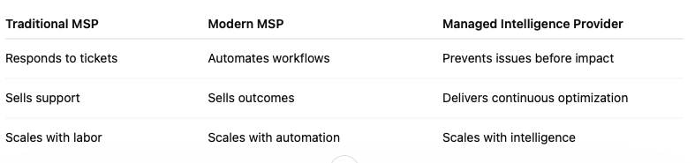
Customers do not want IT effort
They want business outcomes
Reactive IT
Automated IT
Autonomous IT
Predictive IT
Respond after failure
Standardize repeat work
Systems acts
with supervision
Prevent before impact
Traditional MSP | Modern MSP | Managed Intelligence Provider
Responds to tickets | Automates workflows | Prevents issues before impact
Sells support | Sells outcomes | Delivers continuous optimization
Scales with labor | Scales with automation | Scales with intelligence
We can use this format at the bottom vs what we have. Saying Predictive Intelligence enables a MIP
Notes:
Customers do not buy tickets. They buy uptime. They buy resilience. They buy confidence
The future MSP delivers outcomes - not effort.
The next generation MSP is not just a managed service provider. It is a Managed Intelligence Provider.

Slide 10
Suspend your disbelief
What does your world look like when AI agents run operations end-to-end?

Slide 11
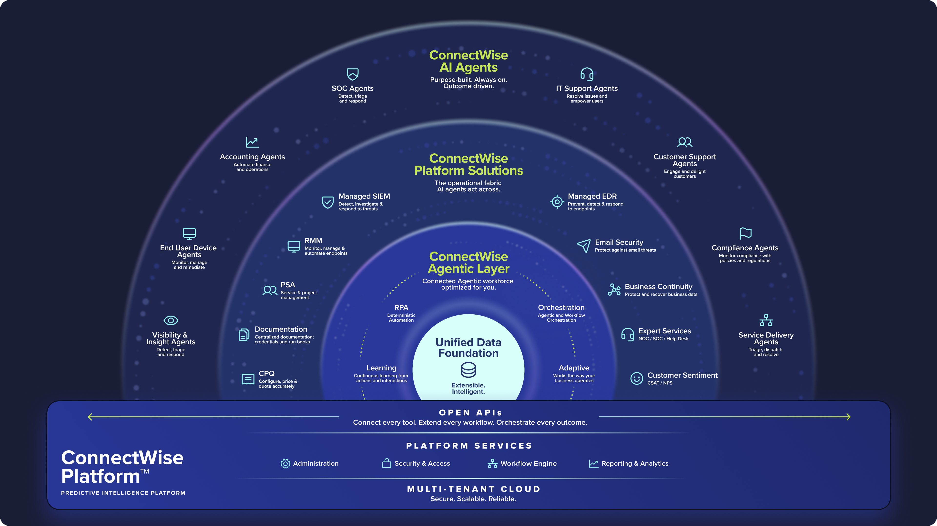
[ADD FINAL HERE]
Predictive intelligence platform
[USE THIS ONE]

Slide 12
The business outcomes that matter
Predictive Intelligence changes the economics of managed services.
45%+
40%
5-10x
Technician productivity improvement
Reduction in resolution time
ROI
Better experience
Operational transformation - not theoretical AI.
Notes:
This is not AI for the sake of AI. This is about productivity, fewer tickets, and profitable scale.

Slide 13

Why those outcomes are real
Prevention becomes possible when the platform sees everything.
DATA LAYER
Unified signals from the MSP business
AUTOMATION LAYER
Standardized actions at machine speed
AI LAYER
Reasoning, pattern recognition, decision support
ORCHESTRATION LAYER
Workflows coordinated across tools
AUTONOMOUS OUTCOMES
Self-healing, optimizing, preventive operations
Unified data. Unified workflows. Unified automation. Unified intelligence.
Notes:
These outcomes happen because the platform sees everything.
Unified data. Unified workflows. Unified automation. Unified intelligence.
This is how prevention becomes possible.

Slide 14

ConnectWise Platform
Unified data
The Operating System
for Predictive IT
Workflow orchestration
Unified Ticketing
Smart automation
Connect data, workflows, automation, AI, and operations into one intelligent system.
Security Controls
AI agents
One platform. One intelligence layer. One operational model.
Notes:
CW Platform is not another product.
It is the operating system for the next generation of MSPs.
The platform that connects data, workflows, automation, AI, and operations into one intelligent system.

Slide 15
Platform impact by 2028–2030
A new operating model for managed services.
Higher margins.
Lower operational burden.
Better customer outcomes.
85+%
99.99+%
issues auto-resolved
uptime
The MSP becomes indispensable.
60+%
technician productivity increase
Notes:
This is the economic transformation of managed services.
Higher margins. Lower operational burden. Better customer outcomes.
The MSP becomes indispensable.

Slide 16
It’s built on eliminating the need to react at all.
Predictive IT
The future of MSPs isn’t built on reacting faster.
From Reactive IT
Notes:
The future of MSPs is not built on reacting faster.
It is built on eliminating the need to react at all.

Slide 17

ONE PLATFORM.
INTELLIGENT ACTION.
REAL RESULTS.
The future of MSPs is yours to build.
The platform powering that future is ConnectWise.
See our 5-Phase Journey to Predictive Intelligence at connectwise.com/predictive-IT
Notes:
This is the next era of managed services.
And ConnectWise intends to lead it.
The future of MSPs is not built on reacting faster.
It is built on eliminating the need to react at all.
The future is Predictive Intelligence — and ConnectWise is the platform powering that future.

