Slide 1
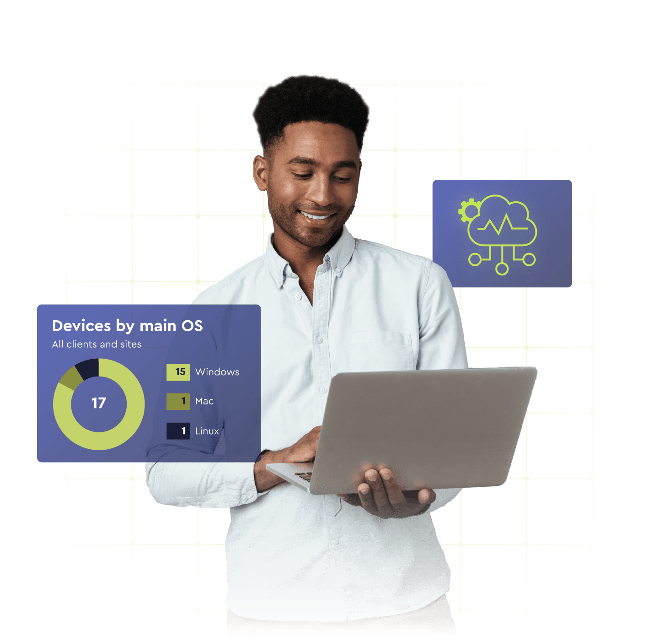
Unlock Operational Service Capacity with ConnectWise AI Agents
Notes:
Opener
Hi Grant. Thanks for all the information you provided on our last call, walking me through your Service Desk operations.
About 2,800 tickets a month, trending toward 3,000
20 to 25 hours a week on triage and dispatch
Up to 25% of tickets reassigned or escalated before the right engineer sees them
You are growing customers and endpoints, but you would rather add capacity than hire at the same pace. Triage, dispatch, and routing are where the strain is showing.
Today I will show how ConnectWise AI Agents handle exactly that work inside your PSA workflow.
Pause. Voice as Grant:
Yeah, that works. Let's go.
ConnectWise AI Agents are designed to help you create more operational capacity by handling repetitive Service Desk work directly within PSA workflows.
This isn't about replacing technicians.
It's about helping your team get more done, resolve issues faster, and scale service delivery without increasing complexity.
As ticket volumes grow and customer expectations continue to rise, MSPs are looking for ways to increase capacity without simply adding more people.
Over the next few slides, we'll show how ConnectWise AI Agents can help reduce escalations, improve service quality, and create the capacity needed to support growth.
Reflect
Your priority is triage, dispatch, and routing. You want capacity without throwing more people at the problem.
That is exactly why we are here today.

Slide 2
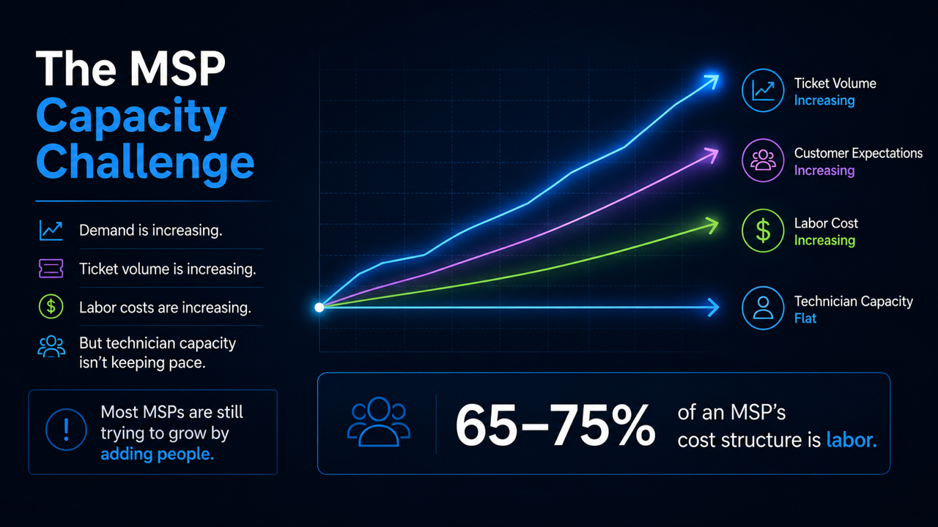
Notes:
Growth Problem
Over the last decade, MSPs have done an incredible job growing their businesses.
But growth has created a new challenge.
Ticket volumes are increasing.
Customer expectations are rising.
Technology environments are becoming more complex.
For many MSPs, the answer has been simple: hire more people.
The Capacity Challenge
The problem is that labour is already one of the biggest costs.
Every new customer.
Every new endpoint.
Every new service.
They all create more demand on the Service Desk.
Revenue can grow, but margins become harder to maintain.
Service quality becomes really hard to keep consistent.
And growth becomes tied to headcount.
A Different Approach
At ConnectWise, we believe there's a better way.
Instead of scaling through people alone, MSPs can start scaling through intelligence.
Earlier this year, ConnectWise acquired zofiQ to help accelerate that vision.
That vision is Predictive IT.
And that's where ConnectWise AI Agents come in.
What Makes AI Agents Different
Automation follows rules.
Copilots provide recommendations.
AI Agents go a step further.
They can understand requests.
They can use context.
And they can take action inside defined workflows.
That helps move work through the Service Desk faster and more consistently.
The Outcome
The outcome is simple.
More operational capacity.
More consistency.
Faster service delivery.
And the ability to grow without increasing headcount at the same rate as demand.
That's why we see ConnectWise AI Agents as an important step toward Predictive IT.
Reflect
You are growing customers and endpoints, with ticket volume creeping toward 3,000 a month. Hiring at the same pace is not the answer you want.
Capacity is the ceiling, not willingness to grow.

Slide 3
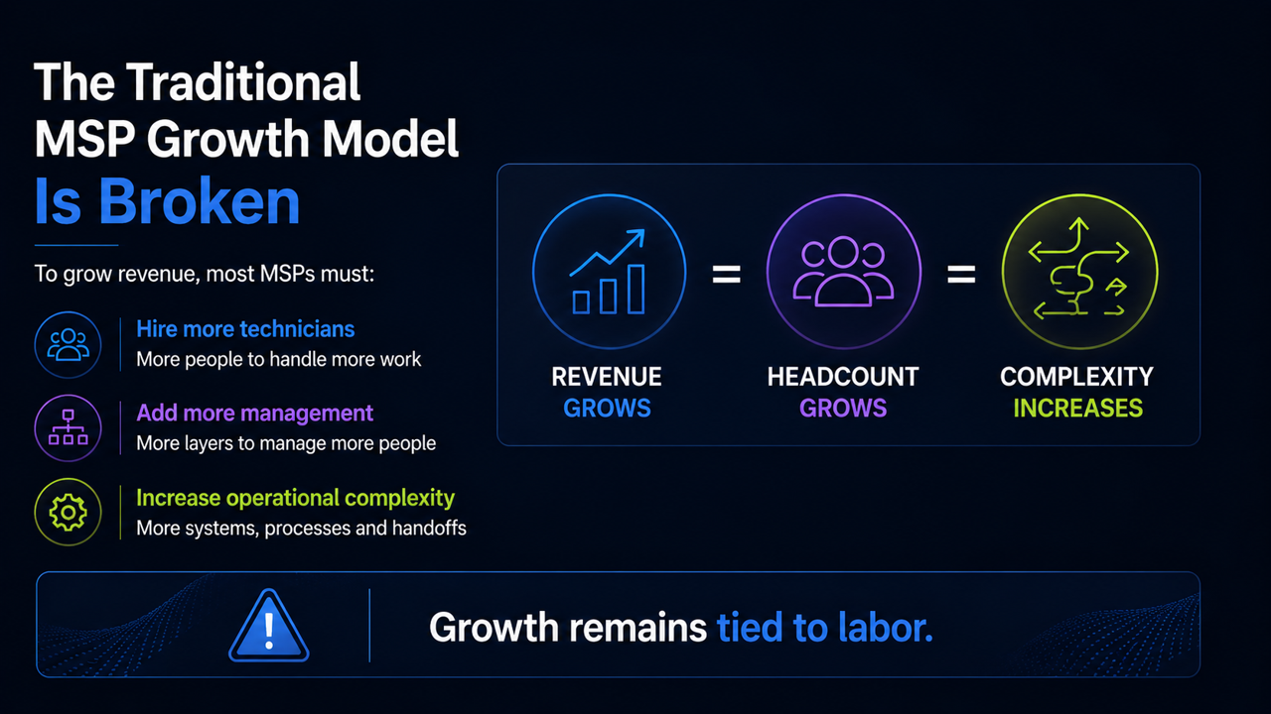
Notes:
The Traditional MSP Growth Model
Most MSPs grow the same way.
More customers create more demand.
More demand creates more tickets.
More tickets usually mean hiring more technicians.
That's worked for years, but it comes with a cost.
The Margin Challenge
Labour is already one of the largest costs in most MSP businesses.
When ticket volume grows faster than revenue, margins become harder to protect.
SLAs stay the same.
Customer expectations continue to rise.
But the cost of delivering those services keeps increasing.
What should feel like growth can start to feel like a capacity trap.
The Questions MSP Leaders Ask
Eventually leadership starts asking the same questions.
Can we take on more customers without a matching hiring plan?
Can we maintain service quality as ticket volume increases?
Can we keep costs under control while continuing to grow?
Can we scale without adding operational complexity at the same rate?
Capacity Becomes the Constraint
Most MSPs have invested in tools.
They've invested in process.
They've invested in training.
The issue isn't effort.
The issue is capacity.
Backlogs grow.
Escalations increase.
Response times slip.
Growth plans slow because delivery capacity becomes the bottleneck.
The Opportunity
Let me be clear.
Growth is the goal.
The question is whether growth needs to remain tied to labour.
What if capacity could scale differently?
What if growth didn't automatically mean more headcount?
That's the opportunity ConnectWise AI Agents are designed to create.

Slide 4
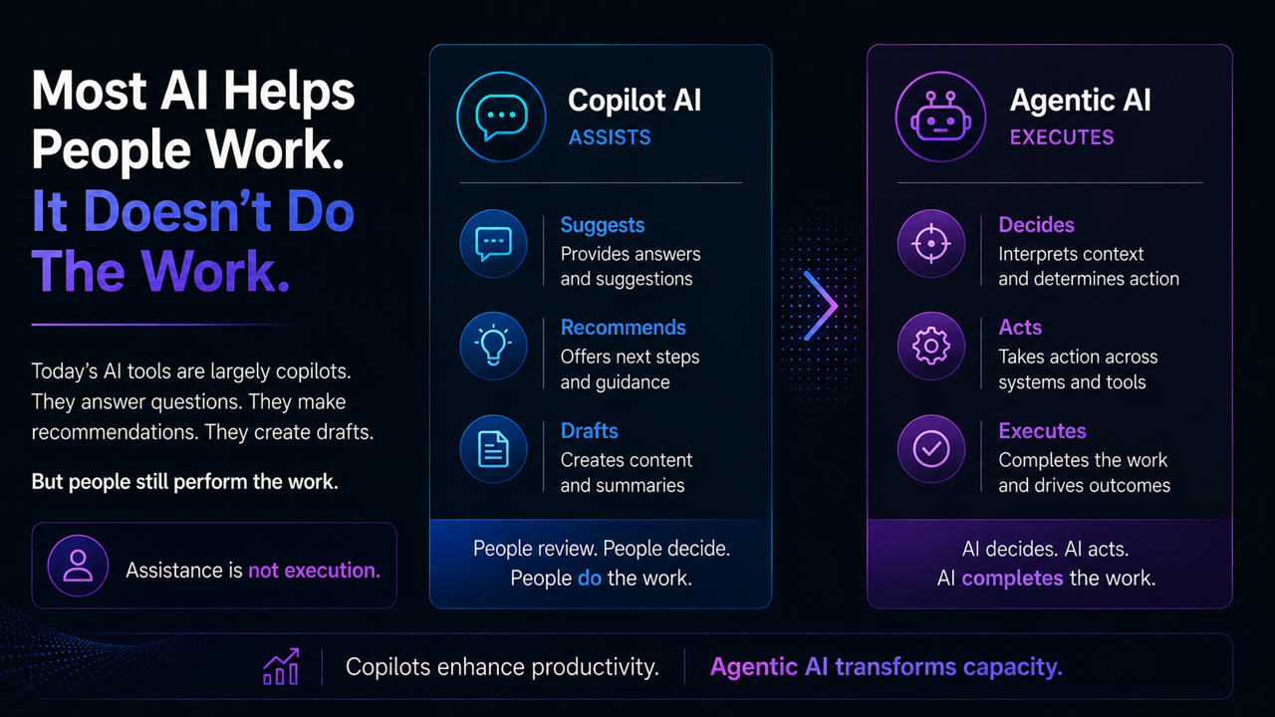
Notes:
Automation
Most MSPs have already invested in automation.
And automation absolutely delivers value.
Scripts, workflows, integrations, and policies help remove repetitive work and improve consistency.
But automation has a limitation.
It only works when you already know exactly what should happen.
Someone still needs to build the rules.
Maintain the logic.
And update the workflow when requirements change.
Copilots
Copilots improved the technician experience.
They can summarise tickets.
Recommend next steps.
Surface useful information.
And help technicians work faster.
That's valuable.
But people still review.
People still decide.
People still do the work.
When ticket volume spikes, the workflow still depends on human attention.
AI Agents
This is where AI Agents are different.
They don't just recommend.
They execute.
AI Agents can understand context.
Determine the next step.
And take action within defined guardrails.
They can classify tickets.
Prioritise work.
Assign owners.
Perform routine tasks.
And document outcomes.
The goal isn't to help people work faster.
The goal is to help the work move faster.
Why It Matters
Most MSPs have already seen value from automation.
Most MSPs have already seen value from copilots.
But many still hit the same ceiling.
Ticket volume keeps growing.
Manual triage still exists.
Escalations still happen.
Capacity remains under pressure.
That's because the real constraint isn't information.
The real constraint is the amount of work that must be completed every day.
The Business Impact
Automation handles known processes.
Copilots assist technicians.
AI Agents help execute the work.
That's how capacity begins to scale differently.
Not by adding more technicians.
But by reducing the manual effort that happens before resolution begins.
That's the shift from productivity to capacity.
Reflect
Much of your triage and routing follows repeatable patterns, but L1 still does it manually every time. You are burning 20 to 25 hours a week on triage and dispatch before resolution even starts.
The patterns are there. The manual effort is what has to come out.

Slide 5
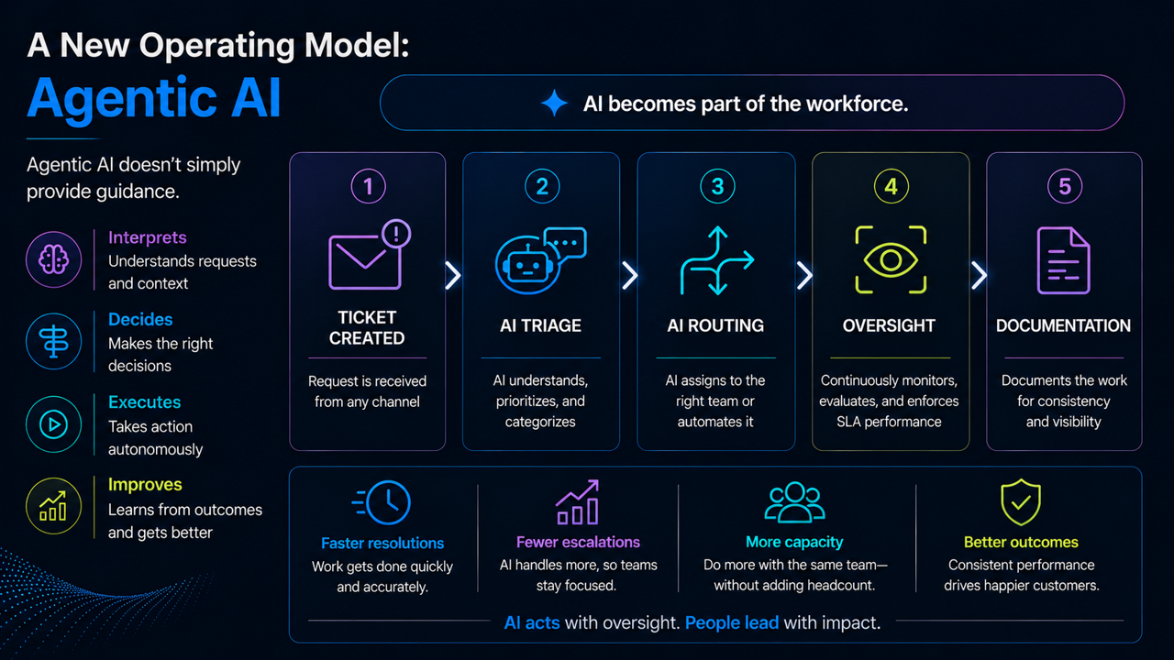
Notes:
Traditional Service Delivery
Historically, service delivery has depended almost entirely on people.
A ticket comes in.
A technician reviews it, determines priority, gathers context, decides what to do next, performs the work, documents the outcome, and moves on to the next request.
Every step depends on human capacity.
On a busy service board, those individual tasks might seem small, but over time they consume a huge amount of delivery capacity before any real work begins.
The Agent-Assisted Model
In the new operating model, technicians are no longer responsible for every operational task.
Instead, AI Agents participate directly in the workflow.
They can analyse incoming requests, classify and prioritise tickets, gather context, perform routine actions, and document outcomes.
The ticket arrives ready for skilled work instead of administrative preparation.
Meanwhile, technicians focus their time where they create the most value: solving complex problems, managing customer relationships, and driving strategic outcomes.
Built-In Oversight
Just as importantly, oversight remains built into the process.
AI Agents aren't operating without visibility or accountability.
MSPs remain in control of the rules, approvals, and governance.
AI Agents expand throughput, but they don't remove accountability.
The Business Impact
This results in a different operating model.
Less time spent on triage.
Less time spent gathering information.
Less time spent documenting routine work.
More time spent on customer outcomes
More time spent on complex technical work.
More time available for growth.
For leadership teams, the value is straightforward.
Fewer hours spent on administrative work means more capacity available for new customers, additional services, and higher-value projects without a proportional hiring event.
Transition
This creates faster resolutions, fewer escalations, and more operational capacity.
Let's look at what those business outcomes actually mean for an MSP.

Slide 6
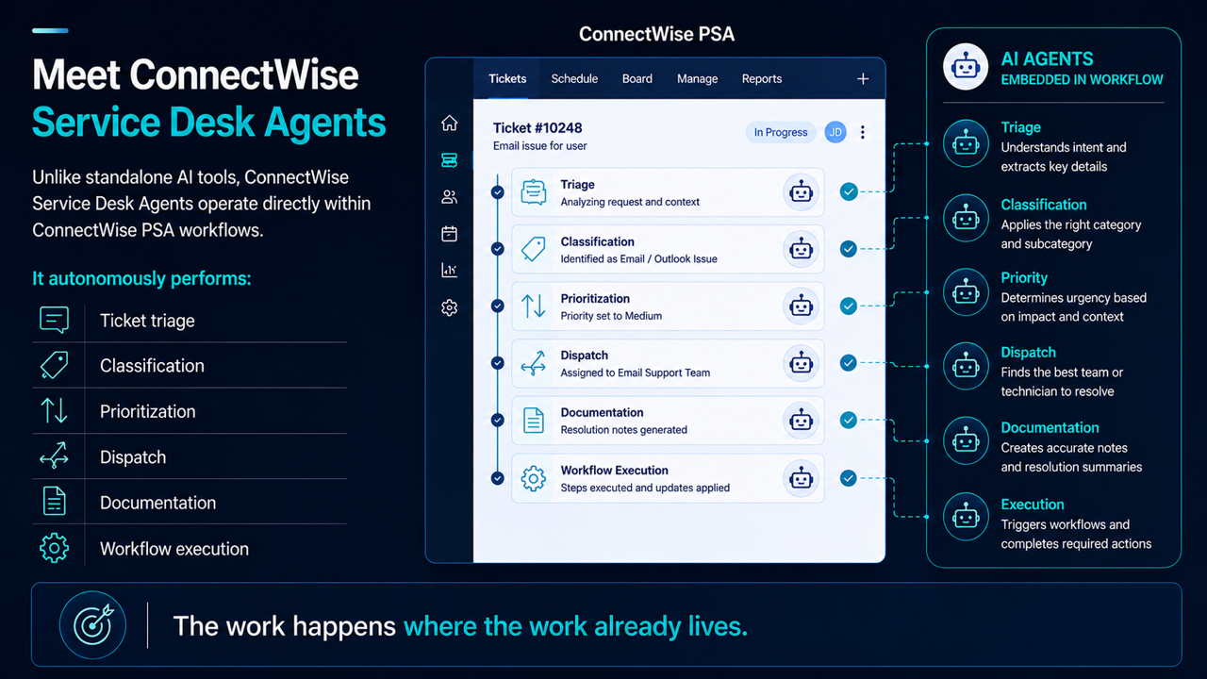
Notes:
Service Desk Agents in Action
Up to this point, we've talked about the challenge and the operating model.
Now let's look at how ConnectWise Service Desk Agents bring that model to life.
The Work Happens Inside PSA
One of the biggest limitations of many AI solutions is that they sit outside the systems where work actually happens.
They provide recommendations.
They generate summaries.
They offer guidance.
But someone still has to take that information and perform the work.
ConnectWise Service Desk Agents take a different approach.
They operate directly inside ConnectWise PSA.
The work happens where the work already lives.
What Service Desk Agents Do
As tickets enter PSA, Service Desk Agents can:
Triage requests.
Classify tickets.
Set priorities.
Assign work.
Generate documentation.
Execute workflow actions.
Instead of acting as a separate tool, the agents become part of the operational workflow.
From Recommendations to Action
This is an important distinction.
A copilot might create a great summary.
But someone still needs to review it, route the ticket, update fields, and move the work forward.
Service Desk Agents go beyond recommendations.
They help move the ticket through the workflow automatically.
Less manual handling.
Less waiting.
Less administrative work.
Why It Matters
Value isn't created when AI generates an answer.
Value is created when work gets completed accurately, consistently, and at scale.
That's why Service Desk Agents focus on workflow outcomes.
Fewer manual touches.
Fewer reassignments.
Faster time to resolution.
More consistency across the Service Desk.
The Business Impact
This isn't about replacing technicians.
It's about removing the repetitive work that slows them down.
AI handles the preparation.
Technicians focus on resolution.
The result is a Service Desk that operates faster, more consistently, and with greater capacity than traditional human-only models.
Reflect
When L1 routes a ticket today, the path is manual end to end. Copy-paste, KB lookup, documentation slow under pressure, and up to 25% of tickets reassigned or escalated.
You want agents native in PSA to triage, classify, and assign. That is the fix you described.

Slide 7
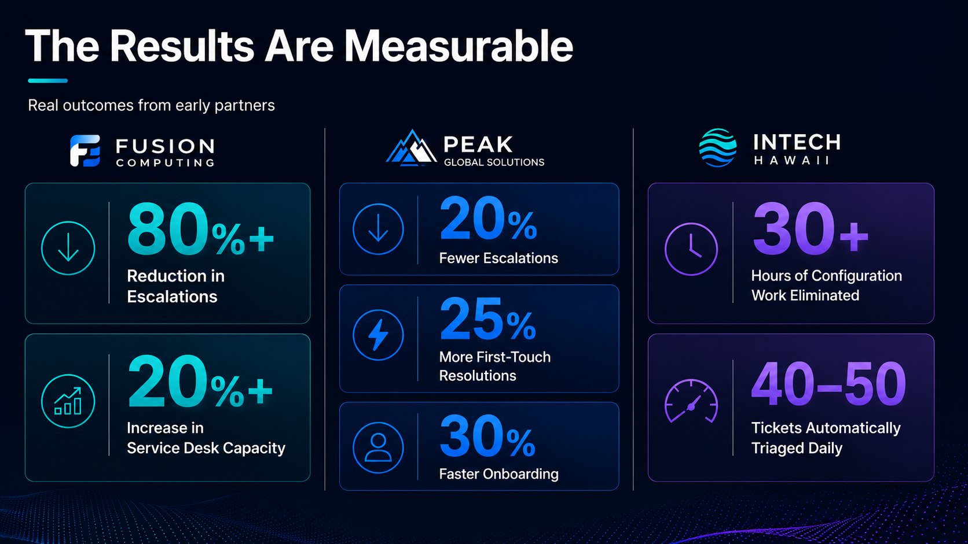
Notes:
Slide opener
The technology is important. But the real question is whether it delivers business outcomes. Let us look at what early partners are achieving today.
Production Results
Everything we've discussed so far sounds good in theory.
But what matters is whether it works in production.
These aren't lab results.
These aren't pilot programs.
These are MSPs using ConnectWise AI Agents in live service environments today.
Fusion Computing
Let's start with Fusion Computing.
Fusion reported an 80% reduction in escalations.
They also achieved more than 20% additional Service Desk capacity.
Those two metrics are closely connected.
When fewer tickets are escalated, senior engineers spend less time on routine work and more time on high-value activities.
That creates capacity without adding headcount.
Peak Global Solutions
Peak Global saw similar results.
They reduced escalations by 20%.
Improved first-touch resolution by 25%.
And accelerated onboarding by 30%.
They also removed hours of manual triage work every week.
That means technicians spend more time helping customers and less time on administration.
Intech Hawaii
Intech Hawaii focused on repetitive operational work.
They eliminated more than 30 hours of Microsoft configuration work.
They automated triage.
And reduced ticket handling from minutes to seconds.
That's the kind of gain that changes how quickly a Service Desk can respond during busy periods.
What These Results Mean
The important thing is that these aren't isolated metrics.
They're all pointing to the same outcome.
Fewer escalations.
Less manual triage.
Faster onboarding.
Better first-touch resolution.
More capacity.
The common pattern is that repetitive operational work is reduced, allowing teams to focus on delivering value to customers.
The Business Impact
These results won't look identical for every MSP.
Every Service Desk starts from a different baseline.
But the areas being improved are familiar to every MSP:
Escalations.
Triage effort.
First-touch resolution.
Onboarding speed.
Service Desk capacity.
Those are the metrics leadership teams already track.
And those are the areas where partners are reporting measurable results.
Reflect
In a pilot, your leadership team would measure success in hours back on the Service Desk first, with triage automated. Not a vanity metric on the wall.
That is the metric you would lead with, same as triage and routing as the first fix.

Slide 8
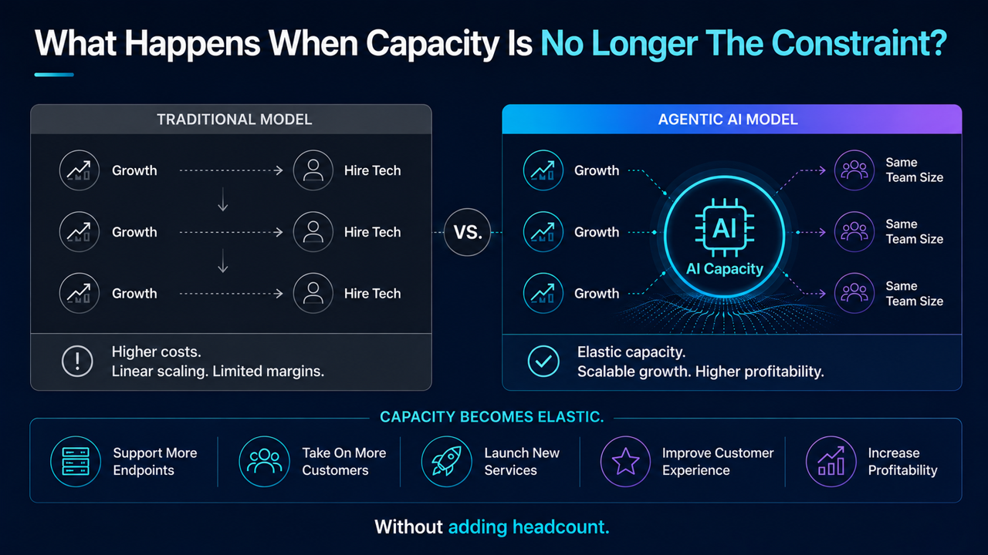
Notes:
Slide opener
When capacity is no longer the main constraint, MSPs gain options. Growth no longer has to stay tied directly to headcount.
Capacity Creates Options
Most MSPs have been conditioned to think about growth in a very specific way.
Growth creates more work.
More work requires more people.
And eventually, growth becomes limited by how quickly you can hire, train, and retrain talent.
That's the model on the left.
Revenue grows.
Headcount grows.
Complexity grows.
What Changes When Capacity Scales?
Now look at the model on the right.
What happens when capacity can grow without adding headcount at the same rate?
What happens when technicians spend less time on admin tasks?
What happens when more work can move through the Service Desk without increasing operational burden?
Your business will start to look very different.
Capacity Becomes Elastic
When capacity increases, MSPs gain options.
They can support more endpoints.
Take on more customers.
Provide new services.
Improve customer experience.
They can do it without a matching hiring plan.
This is why we focus on capacity.
Because capacity creates choices.
Growth Without Linear Hiring
I'm not saying stop hiring.
I'm saying hire differently.
Instead of hiring to keep up with ticket volume, they can hire for growth, specialization, and strategic initiatives.
The focus shifts from keeping up with demand to expanding the business.
The Business Impact
More capacity means more than efficiency.
It means better margins.
More consistency.
More strategic work.
And more opportunities to grow.
That's the real value of ConnectWise AI Agents.
Not just helping technicians work faster.
Helping MSPs scale differently.
Reflect
So if capacity is no longer the primary constraint on growth, what could your business look like twelve months from now?

Slide 9
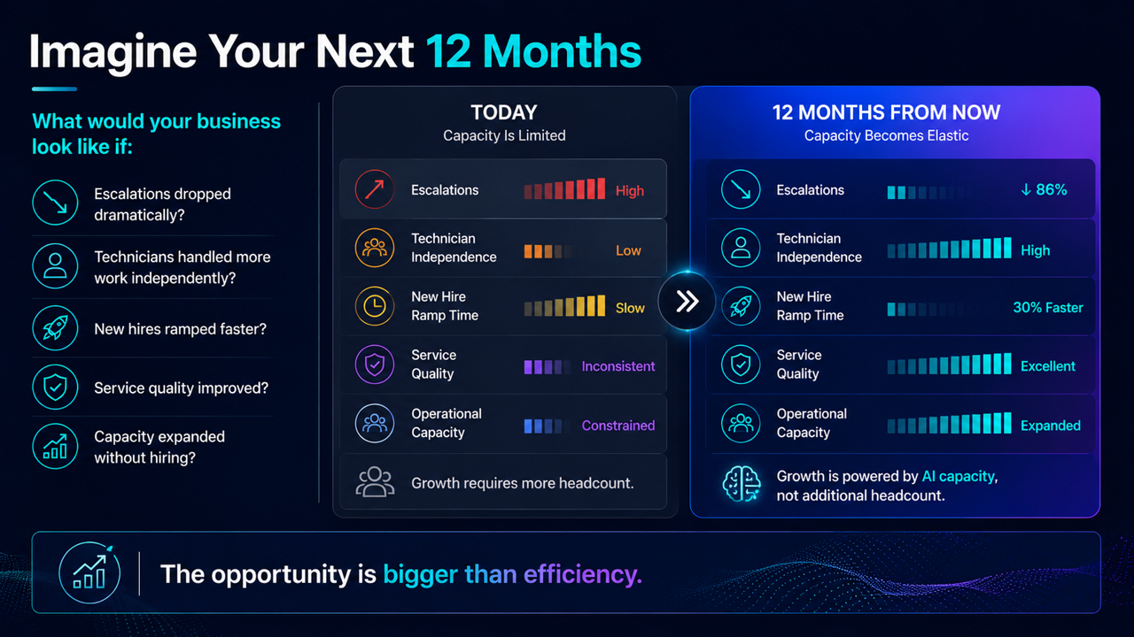
Notes:
Imagine Your Next 12 Months
Imagine where your business could be twelve months from now.
A future where:
Growth feels manageable instead of stressful.
Operational capacity grows alongside demand.
Fewer Escalations
What would change if escalations became the exception instead of the norm?
Senior engineers spend less time acting as a safety net.
Routine work gets resolved earlier in the process.
Teams stay focused on the work that creates the most value.
Greater Technician Independence
What if technicians could resolve more issues independently?
Fewer handoffs.
Less waiting.
Less rework.
More tickets reaching resolution without multiple teams becoming involved.
Faster Ramp-Up
What if new hires became productive faster?
Knowledge and best practices are built into the workflow.
Guidance is available when needed.
New team members contribute sooner and with greater confidence.
Consistent Service Delivery
What if service quality became more consistent?
Across every technician.
Every shift.
Every customer.
Every interaction.
Customers receive the same experience regardless of who handles the ticket.
Expanded Capacity
What if your organisation had access to significantly more operational capacity?
Not because people are working harder.
But because less time is being spent on triage, routing, documentation, and repetitive tasks.
More work gets completed.
With less operational friction.
A More Scalable Business
For many MSPs, growth creates pressure.
More customers create more work.
More work creates more complexity.
More complexity creates more overhead.
But when capacity expands faster than operational burden, growth starts creating opportunity instead of pressure.
You can take on new customers with confidence.
Launch new services.
Improve customer experience.
And build a more scalable business.
Start Small
The good news is you don't have to transform everything at once.
Most successful partners start with a single workflow.
They prove value.
Measure the results.
Then expand.
One workflow at a time.
One outcome at a time.
Reflect
Vision without a starting point stays theoretical. The next slide turns this twelve-month vision into a practical plan for getting started.

Slide 10
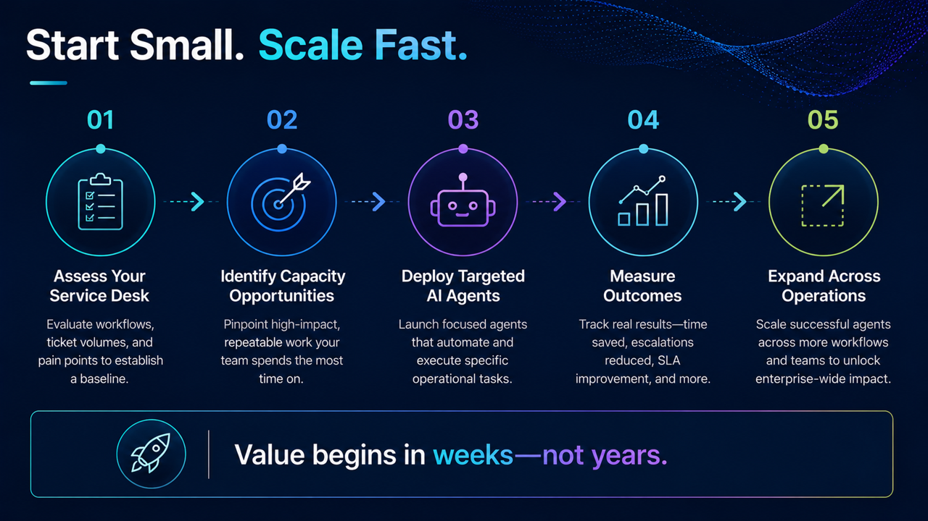
Notes:
Assess Your Service Desk
Most MSPs already know where the pain lives.
The challenge isn't finding problems.
It's understanding which problems are worth solving first.
The first step is identifying the workflows that create the most operational friction.
The areas where work slows down before resolution even begins.
Identify Capacity Opportunities
Not every workflow delivers the same return.
The best starting points are usually the ones with the highest volume and the most consistency.
Think about triage.
Dispatching.
Prioritisation.
Documentation.
Processes that happen every day and follow a predictable pattern.
Deploy Targeted AI Agents
Once the opportunity is identified, AI Agents are deployed against that specific workflow.
With clear rules.
Clear oversight.
And clear ownership.
This isn't about turning on autonomous operations across the entire Service Desk.
It's about solving one operational problem well.
Measure Outcomes
The next step is validation.
Did reassignments decrease?
Did response times improve?
Did ticket handling become more consistent?
Did service quality improve?
The goal is to validate operational improvement with real data.
Expand Across Operations
Once a workflow proves successful, the same approach can be applied elsewhere.
Additional boards.
Additional teams.
Additional use cases.
Each deployment builds confidence and operational maturity.
Value Through Execution
The reason this approach works is because it's practical.
You don't want to start at the end.
You start with a workflow.
You prove the outcome.
Then you decide where to go next.
That's how to successfully move from experimentation to production.
Reflect
Triage and routing are your starting point. For anything serious, you and your Service Desk lead are in the room.
You own the evaluation on the Service Desk, not a generic overview.

Slide 11
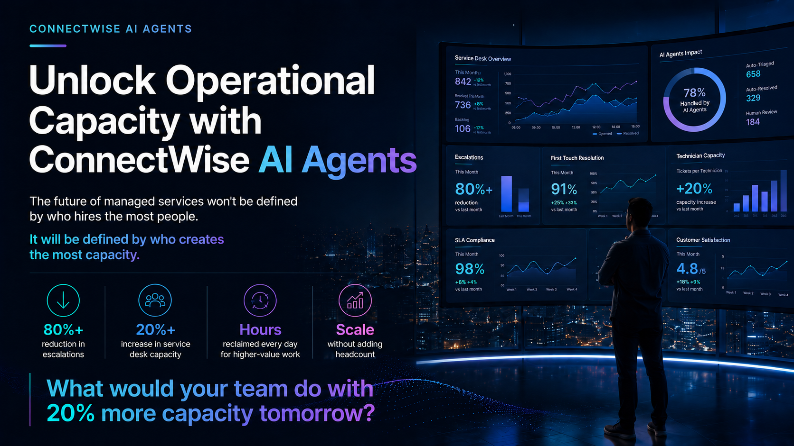
Notes:
Slide opener
The MSPs that gain the most value from AI will not necessarily be the first to adopt it. They will be the ones that apply it to real operational problems and scale what works.
The Future Belongs To Capacity
Throughout this session, we've talked about a challenge every MSP faces.
How do you continue to grow without creating more operational complexity?
For years, the answer has been simple.
Hire more people.
More customers meant more technicians.
More demand meant more headcount.
But the future of managed services won't be defined by who hires the fastest.
It will be defined by who creates the most capacity.
A Different Way To Scale
ConnectWise AI Agents help MSPs absorb operational work that traditionally required technician time.
Triage.
Routing.
Documentation.
Classification.
The repetitive work that keeps Service Desks busy but does not directly solve customer problems.
The result is a service organization that can operate with greater consistency and efficiency as demand grows.
What Production Results Tell Us
The outcomes we've reviewed today all point to the same trend.
Fewer escalations.
Greater Service Desk capacity.
Faster onboarding.
More first-touch resolutions.
Hours returned to the team every day.
Not because people are working harder.
Because work is being handled differently.
The Real Question
So as you think about your own business, I'd leave you with one question.
What would your team do with 20% more capacity tomorrow?
Would you support more customers?
Launch new services?
Improve customer experience?
Increase profitability?
Improve SLA performance?
Or simply give your team more time to focus on the work that creates the most value?
Reflect
At your volume, that capacity goes into absorbing growth without hiring at the same pace and protecting SLAs and margin. That is what good looks like for your shop.
Synthesise: you say
So we're aligned. We’re looking at:
About 2,800 to 3,000 tickets a month
Manual triage and routing as the biggest drain
Growth on customers and endpoints with low appetite for hiring at the same pace
ConnectWise AI Agents natively in your PSA are built for exactly that triage and dispatch work
Closing
That's the opportunity ConnectWise AI Agents are designed to unlock.
Not replacing people.
Creating capacity.
Helping your business scale without accepting the traditional trade-off between growth, quality, and profitability.
Thank you.

