Slide 1

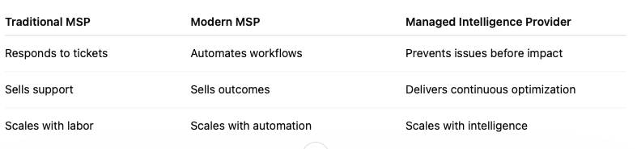
Customers do not want IT effort.
They want business outcomes.
Reactive IT
Automated IT
Autonomous IT
Predictive IT
Respond after failure
Standardize repeat work
Systems acts
with supervision
Prevent before impact
Traditional MSP | Modern MSP | Managed Intelligence Provider
Responds to tickets | Automates workflows | Prevents issues before impact
Sells support | Sells outcomes | Delivers continuous optimization
Scales with labor | Scales with automation | Scales with intelligence
We can use this format at the bottom vs what we have. Saying Predictive Intelligence enables a MIP
Notes:
Opener
Hi Grant. Thanks for all the information you provided on our last call, walking me through your Service Desk operations.
About 2,800 tickets a month, trending toward 3,000
20 to 25 hours a week on triage and dispatch
Up to 25% of tickets reassigned or escalated before the right engineer sees them
You are growing customers and endpoints, but you would rather add capacity than hire at the same pace. A loaded hire runs 70 to 80 thousand a year with a three to four month ramp. Triage, dispatch, and routing are where the strain is showing.
Today I will walk through where IT service delivery is heading and where your shop sits on that path.
Let's start with a simple reality.
Your customers don't care how many tickets you closed last month.
They don't care how many scripts you wrote or how many hours were spent resolving incidents.
What they care about is whether their business is secure, productive, and running smoothly.
They're buying outcomes, not effort.
The challenge is that many MSPs are still operating with service delivery models built around effort.
As customer expectations increase and ticket volumes continue to grow, that model becomes harder to scale.
That's why the industry is moving through the evolution shown on this slide.
Reactive IT
Most MSPs started here.
Something breaks, a ticket gets created, and the team responds.
For years, success was measured by how quickly you could react after a problem occurred.
The reality is that reactive support doesn't scale particularly well.
Every issue still requires technician time, and customers have already felt the impact before work even begins.
As ticket volume grows, the business eventually reaches a point where demand grows faster than delivery capacity.
At that point, growth usually means hiring more people just to keep up.
Automated IT
The industry's first response was automation.
Scripts, workflows, templates, and standardised processes allowed MSPs to handle more volume without adding headcount at the same rate.
For most MSPs, automation has already delivered significant value.
But there's still a lot of work happening before resolution even starts.
Teams are still spending time routing tickets, gathering information, reviewing customer history, and getting work to the right technician.
Automation improved efficiency, but many MSPs still have operational bottlenecks in the workflow.
Autonomous IT
The next stage is autonomous operations.
This is where AI starts performing defined tasks while people remain in control.
The goal isn't to replace technicians.
The goal is to remove repetitive operational work so technicians can spend more time solving problems and delivering value.
Think about activities like ticket routing, gathering information, enriching tickets, and triggering workflows.
These are tasks that need to happen, but don't necessarily need a person involved every single time.
This is where MSPs begin scaling capability, not simply scaling headcount.
Predictive IT
The final stage is Predictive IT.
Instead of responding to problems after they happen, the goal is to identify risks and patterns before they impact the customer.
At that point, the conversation changes.
You're no longer measured by how quickly you respond to issues.
You're measured by how effectively you prevent them.
That's a very different operating model.
It's also why you'll notice the language changes on the right-hand side of the slide.
The traditional MSP responds to tickets, sells support, and scales through labour.
The modern MSP automates workflows, sells outcomes, and scales through automation.
The next evolution is the Managed Intelligence Provider.
An organisation that uses intelligence, automation, and data to prevent issues before they impact customers, improve service delivery, and scale without simply adding more people.
The question isn't whether AI and predictive operations are coming.
The question is whether your current operating model can keep pace as customer expectations rise, ticket volumes grow, and skilled resources become harder to find.
Reflect (after Slide 1)
When I map your Service Desk to this ladder, I would put you mostly reactive. You have automation in pockets, but manual triage, up to 25% reassignment or escalation, and SLA pressure mean triage, dispatch, and routing are still heavy on people.
The strain is still on people, not automation. That is the gap we need to close.

Slide 2
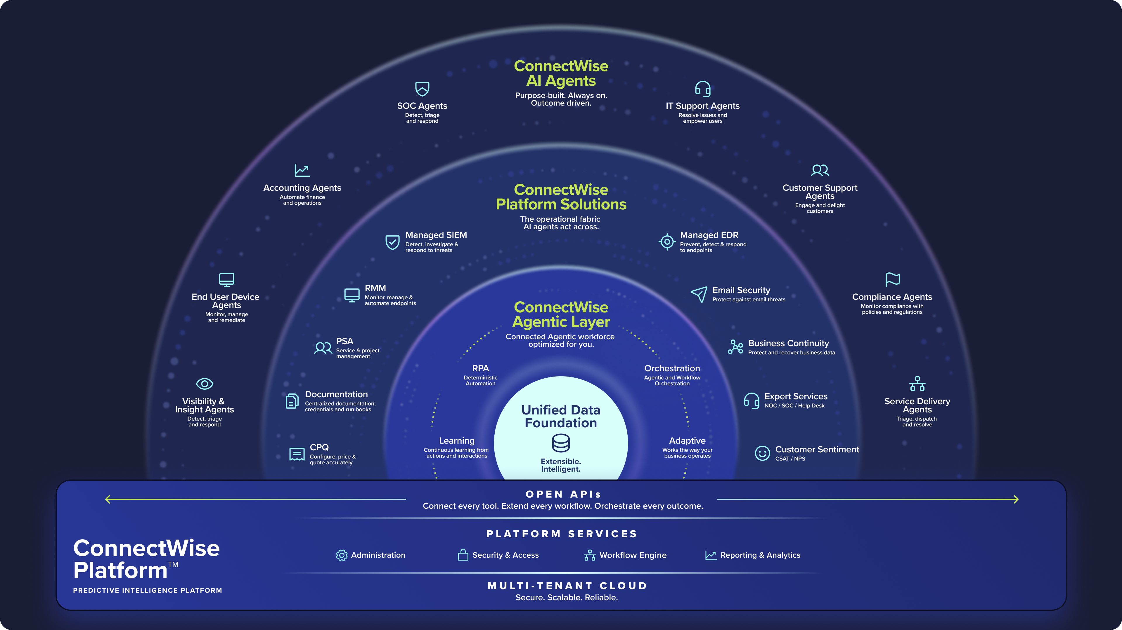
[ADD FINAL HERE]
[USE THIS ONE]
Predictive Intelligence Platform
Notes:
Slide opener
If customers are buying outcomes instead of effort, MSPs need the ConnectWise Platform to deliver those outcomes consistently.
That is where the ConnectWise Platform comes in.
The Challenge
ConnectWise isn't just adding AI to existing products.
What you're looking at is the ConnectWise Platform, designed to bring together the systems MSPs already use every day.
Across PSA, RMM, cybersecurity, backup, documentation, and other tools, MSPs generate enormous amounts of operational data.
Historically, that information has been spread across multiple systems. Ticket data sits in one place, asset information in another, customer agreements somewhere else, and technicians often end up connecting the dots manually.
The result is more effort, more handoffs, and more time spent gathering information before anyone starts solving the issue.
Unified Data Foundation
At the centre of the ConnectWise Platform is the Unified Data Foundation.
The goal is simple.
Bring operational data together so the ConnectWise Platform understands not just what's happening, but also the customer, the environment, and the business context behind it.
Why is that important?
Because every time a ticket arrives without context, someone has to stop and do administrative work before they can start solving the problem.
They look up customer information.
They review previous tickets.
They check assets and configurations.
They work out where the ticket should go.
None of that work actually resolves the issue.
It simply gets the ticket ready for resolution.
The more context the ConnectWise Platform already understands, the less manual effort is required before work can begin.
That's where efficiency starts to scale.
ConnectWise Agentic Layer
The next layer is the ConnectWise Agentic Layer.
The easiest way to think about it is this:
A copilot helps people work.
An agent helps get work done.
Instead of simply answering questions, agents can take action, trigger workflows, and execute tasks across the ConnectWise Platform.
That allows MSPs to move beyond traditional automation and start embedding intelligence directly into everyday service delivery.
ConnectWise AI Agents
At the top of the ConnectWise Platform are ConnectWise AI Agents.
These are designed specifically for MSP workflows.
Whether it's service delivery, customer support, security operations, accounting, or compliance, the objective is the same:
Reduce manual effort.
Improve consistency.
Increase throughput.
Help teams handle more work without adding headcount at the same rate.
For most MSPs, that's the business case.
How do we get more value from the team we already have?
How do we create more capacity without creating more complexity?
That's exactly what AI Agents are designed to address.
What Predictive IT Means
When we talk about Predictive IT, we're not talking about another dashboard or another reporting tool.
We're talking about using connected data, automation, and AI to identify risks earlier, take action faster, and continuously improve outcomes.
The key difference is that the intelligence, the data, and the workflows all exist within the ConnectWise Platform.
That means AI isn't sitting beside the workflow.
It's operating within the workflow.
That's what enables the ConnectWise Platform to move beyond informing people and start helping drive outcomes.
And that's what this architecture is designed to deliver.
Reflect (after Slide 2)
You run cloud PSA and RMM with eighteen users in PSA daily, but the ticket path still depends on manual work between systems, not one clear picture.
The manual glue is still there before anyone resolves the ticket. That is what the ConnectWise Platform has to fix.

Slide 3

The business outcomes that matter
Predictive Intelligence changes the economics of managed services.
45%+
40%
5-10x
Technician productivity improvement
Reduction in resolution time
ROI
Better experience
Operational transformation - not theoretical AI.
Notes:
Slide opener
Now that we have looked at the ConnectWise Platform, let us talk about what MSP leaders really care about. The business outcomes it delivers.
Economics
Predictive Intelligence changes the economics of managed services.
And that's really the key message on this slide.
This is about operational transformation, not theoretical AI.
MSP owners and leadership teams don't invest in AI because it's interesting. They invest when it helps protect margins, improve service delivery, and support growth without increasing costs at the same rate.
Let's look at the outcomes on the screen.
Productivity Improvement
The first metric is a 45%+ improvement in technician productivity.
For MSPs, that means getting more output from the team you already have.
This isn't about asking technicians to work harder.
It's about removing manual effort before and during resolution so technicians spend more time solving problems and less time gathering information, updating tickets, routing work, and completing repetitive tasks.
The result is greater throughput from the same delivery team.
Resolution Time
The second metric is a 40% reduction in resolution time.
Every MSP understands the impact of faster resolution.
It improves SLA performance, reduces backlog pressure, and creates a better customer experience.
When ticket volumes start growing faster than staffing levels, resolution time is often one of the first areas to suffer.
Reducing that pressure helps teams stay ahead of demand while maintaining service quality.
ROI
The third metric is 5 to 10 times ROI.
This is typically the metric leadership teams care about most.
The business question is simple:
Does the value delivered by the ConnectWise Platform and ConnectWise AI Agents exceed the cost of manual effort, escalations, additional hiring, and operational inefficiencies?
The goal is to help MSPs do more with the resources they already have while reducing the cost of growth.
Better Customer Experience
The final outcome is a better customer experience.
This is about more than customer satisfaction scores.
It's about delivering a more consistent service experience.
Customers notice when tickets are routed correctly the first time, when response times are faster, and when technicians already have the context they need.
Consistency builds trust, and trust drives customer retention.
Bringing It Together
What's important is that these outcomes work together.
When an MSP reduces repetitive work, resolves issues faster, and creates more capacity from the team they already have, the benefits show up across the entire business.
Margins improve.
Customer experience improves.
Scalability improves.
Those are the outcomes leadership teams invest in.
The benchmarks shown on this slide are directional.
Every MSP has a different starting point and will measure success against its own baseline.
But these are the categories leadership teams evaluate when assessing operational improvement.
Behind these results are challenges every MSP is familiar with:
Growing ticket volumes.
Manual triage and routing.
Senior engineers spending too much time on escalations.
And hiring plans that struggle to keep pace with customer demand.
When those pressures build, margins shrink, service quality suffers, or sometimes both.
Predictive Intelligence on the ConnectWise Platform is designed to address those challenges before they become business problems.
Reflect (after Slide 3)
When I stack your numbers against these outcomes, productivity and capacity are where the pain lands first.
You are at roughly 2,800 to 3,000 tickets a month and trending up, burning 20 to 25 hours a week on triage, and essentially all of it is still manual L1 before work starts.
You would rather add capacity with the team you have than hire at the same pace as growth. Productivity and capacity are your levers.

Slide 4
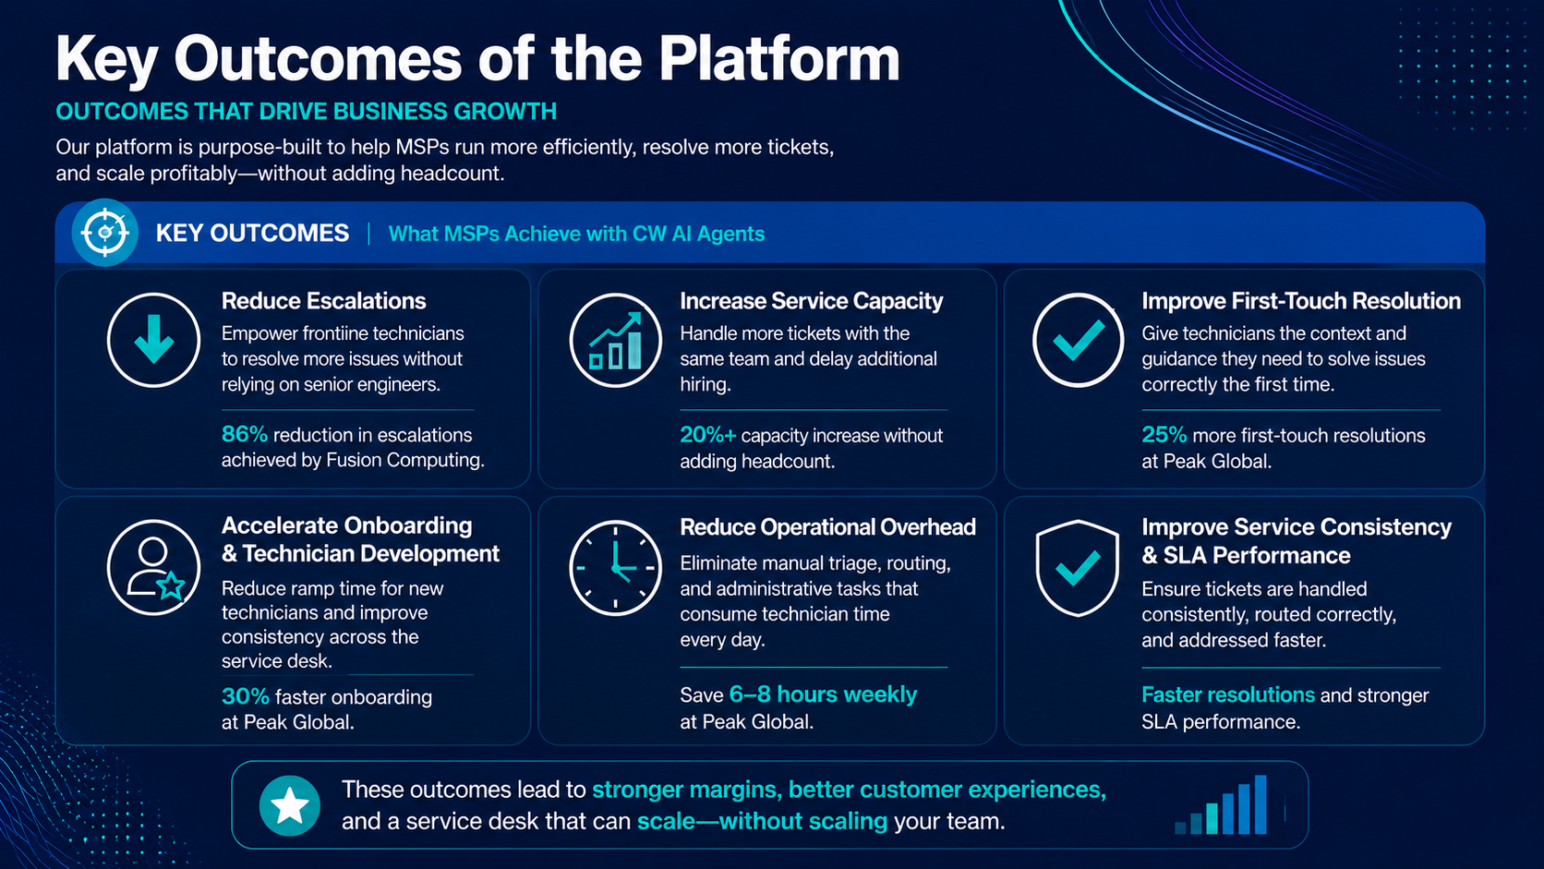
Notes:
Slide opener
These are some of the key outcomes delivered by the ConnectWise Platform.
Now let us look at what those outcomes actually look like in day-to-day MSP operations.
Outcomes
This is where the conversation moves from challenges to business impact.
The ConnectWise Platform helps MSPs improve efficiency, handle more volume, and grow profitably without increasing headcount at the same rate.
Let's look at what that means in practice.
Reduced Escalations
The first outcome is reduced escalations.
Every MSP knows that escalations are expensive.
When tickets move unnecessarily to senior engineers, you're using your most experienced resources on work that could have been resolved earlier in the process.
That impacts margin in two ways.
First, through additional handoffs and rework.
Second, through senior engineers spending time on work that doesn't require senior-level expertise.
Reducing escalations keeps senior resources focused on the work that creates the most value.
Increased Service Capacity
The second outcome is increased service capacity.
This is about supporting more tickets, endpoints, and customers with the team you already have.
For MSPs, that's one of the biggest drivers of profitable growth.
As new customers come onboard and ticket volumes rise, the business can absorb that demand without needing a matching hiring plan every time revenue grows.
Improved First-Touch Resolution
The next outcome is improved first-touch resolution.
Customers judge responsiveness by how quickly an MSP understands their issue and starts moving toward a solution.
When technicians have the right information and context from the start, they're more likely to resolve issues correctly the first time.
That improves customer experience, strengthens SLA performance, and reduces rework across the Service Desk.
Faster Onboarding and Development
Another important outcome is faster onboarding and technician development.
Every MSP faces the challenge of bringing new team members into the business and getting them productive as quickly as possible.
When knowledge, process, and context are embedded into workflows, new technicians can ramp faster and become productive sooner.
That allows service capacity to grow more efficiently as the business expands.
Reduced Operational Overhead
The next outcome is reduced operational overhead.
Most MSPs have a surprising amount of technician time tied up in administrative work.
Triaging tickets.
Routing work.
Gathering information.
Updating records.
Managing handoffs.
All of those activities are necessary, but none of them directly resolve customer issues.
Reducing that overhead lowers the cost of delivery and frees technicians to focus on higher-value work.
Improved Service Consistency and SLA Performance
The final outcome is improved service consistency and SLA performance.
As MSPs grow, consistency becomes increasingly important.
Customers expect the same experience regardless of who handles their request.
When work is structured, routed correctly, and managed consistently, SLA performance improves and service delivery becomes more predictable.
That's what allows MSPs to scale without service quality suffering as volume increases.
Bringing It All Together
What's important is that none of these outcomes exist in isolation.
They're all connected.
Work comes in.
ConnectWise AI Agents automatically structure and enrich the ticket.
Relevant customer and operational context is already available through the ConnectWise Platform.
The work is routed correctly, technicians start with better information, and issues are resolved faster.
That's what MSP leadership is investing in.
Not individual features.
Not another dashboard.
A more efficient operating model that improves margin, creates additional capacity, and supports growth at scale.
Reflect (after Slide 4)
Your first-quarter fix is triage, dispatch, and routing. In the first ninety days, your leadership team would measure success on fewer escalations, more capacity, and lower overhead, not a vanity metric on the wall.
Triage and routing come first, with scale, fewer escalations, and lower overhead in the same frame.

Slide 5
Predictive Intelligence Journey
A transformation from augmentation to predictive operations.
Phase 1
Phase 2
Phase 3
Phase 4
Phase 5
Operationalize AI
Extend the Workforce
Supervise AI
Autonomous Ops
Predictive Intelligence
2024-2026
2025-2026
2026-2027
2027-2028
2028-2030
Embed AI copilots in PSA/RMM
Automate ticket summarization, scripting, documentation
Early automation for cost reduction
AI assists every engineer in real time
Knowledge becomes instant and contextual
Junior techs perform at mid-level
AI executes tasks with human oversight
Engineers manage workflows, not tickets
Governance, control, and confidence in AI actions
AI runs NOC/SOC workflows
Cross-platform orchestration (endpoint, cloud, network, security)
Humans manage exceptions – not operations
Agents learn and proactively solve problems before users are impacted
Neuro-net thinking
Fully predictive, self-optimizing IT environments
Notes:
Slide opener
These outcomes deliver value today, but they are also part of a much broader journey toward Predictive Intelligence.
Journey
Predictive IT is a journey, not a single leap.
Most MSPs don't wake up one morning and suddenly become fully autonomous.
The reality is that every MSP is somewhere on this journey already. The goal isn't to get to Phase Five overnight. The goal is to take the next step that delivers measurable business value.
This slide shows how that journey evolves.
Phase One: Operationalize AI
This is where most MSPs begin.
AI is embedded into everyday workflows within ConnectWise PSA and ConnectWise RMM.
The focus is on reducing manual effort through ticket summarisation, scripting assistance, documentation, and day-to-day productivity improvements.
The objective is simple: save time and improve efficiency without changing how your Service Desk operates.
For many MSPs, this is where they see their first measurable ROI from AI.
Phase Two: Extend the Workforce
The next step is extending the workforce.
AI becomes part of the technician experience, providing guidance, recommendations, and relevant knowledge directly within the workflow.
Instead of relying on tribal knowledge or digging through documentation, technicians get the information they need when they need it.
For MSPs, this helps close skills gaps, improve consistency, and increase capacity without hiring at the same rate.
It also helps newer technicians become productive much faster.
Phase Three: Supervise AI
This is where ConnectWise AI Agents start taking action.
Instead of simply helping technicians work, agents begin performing defined tasks with human oversight.
The focus shifts from managing individual tickets to managing the overall workflow.
Activities such as triage, categorisation, routing, and ticket enrichment become increasingly automated while maintaining governance and control.
For many MSPs, this is where some of the strongest near-term ROI can be achieved.
Phase Four: Autonomous Operations
The next stage is autonomous operations.
AI begins managing larger operational workflows across service, network, cloud, and security environments.
People spend less time managing routine activities and more time managing exceptions, policy, and outcomes.
For most MSPs, this is a future objective rather than a starting point.
Phase Five: Predictive Intelligence
The final stage is Predictive Intelligence.
At this point, AI is continuously learning from operational patterns and helping prevent issues before they impact customers.
The focus shifts from responding to problems to preventing them altogether.
This is the long-term vision of the ConnectWise Platform.
But the most important message on this slide is that MSPs don't need to reach Phase Five to realise value.
The goal is measurable ROI at every stage of the journey.
For many partners, the most practical place to start is applying ConnectWise AI Agents to existing ticket and service workflows with the right level of oversight and control.
That's often where the fastest and most measurable business outcomes are achieved.
Bringing It All Together
When you look across all five phases, the pattern is consistent.
You move from manual effort to automation, from automation to orchestration, and ultimately to prediction.
Each stage builds on the one before it.
Each stage delivers value.
And each stage helps MSPs scale more efficiently.
Reflect (after Slide 5)
Your sensible next step is not predictive overnight. It is phase two to phase three on the Service Desk, with AI assisting first and then executing triage and dispatch while your team oversees.
You want triage and routing automated on your Service Desk first, not a generic overview.
Synthesise: you say before close
So we're aligned.
About 2,800 to 3,000 tickets a month
Manual triage and routing as the biggest drain
Growth on customers and endpoints with low appetite for hiring at the same pace
Supervised AI on the Service Desk makes the most sense for triage and dispatch first
You're on the early part of this journey. The first practical step is ConnectWise AI Agents on the Service Desk.
Close: deck + next step
MSPs don't need to complete the entire journey all at once.
The most practical place to start is identifying where ConnectWise AI Agents can remove manual effort, improve consistency, and create capacity within your existing service workflows.
I'd love to show you what that looks like in practice.
Reflect (close)
The logical next step is the focused session we talked about. A Thirty to forty-five minutes on ConnectWise AI Agents built around your Service Desk, covering triage, dispatch, capacity, and SLA impact, with you and your Service Desk lead. Not a generic overview.

